Slide 1


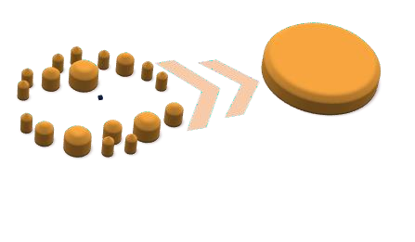

CUSTOMER PERSONALITY ANALYSIS
Team: P394 (GROUP 1)
Members: Ishwari Tale
Sneha Singh
Mithun Potlapally Jayathwala Chandana
Suprith Korishettar Anjali Pal
Mentor: Dilavar Basha

Slide 2
INTRODUCTION
Customer Personality Analysis is a method used to understand the behavioural patterns, preferences, and personality traits of customer.
This analysis involves collecting and interpreting data to categorize customers based on their unique characteristics.
The insights gained from customer personality analysis can help businesses tailor their marketing strategies, improve customer service, and enhance product development to better meet the needs and preferences of their target audience.

Slide 3
BUSINESS OBJECTIVE
Customer personality analysis helps a business to modify its product based on its target customer from different types of customer segments.
Finding the potential customers by analysing the behaviour of them is useful to understand the targeted customers.
For example, instead of spending money to market a new product to every customer in the company’s database, a company can analyse which customer segment is most likely to buy the product and then market the product only on that particular segment.
Do a comparative analysis and need to deploy the clustering application

Slide 4
TARGET
Need to perform clustering to summarize customer segments.

Slide 5
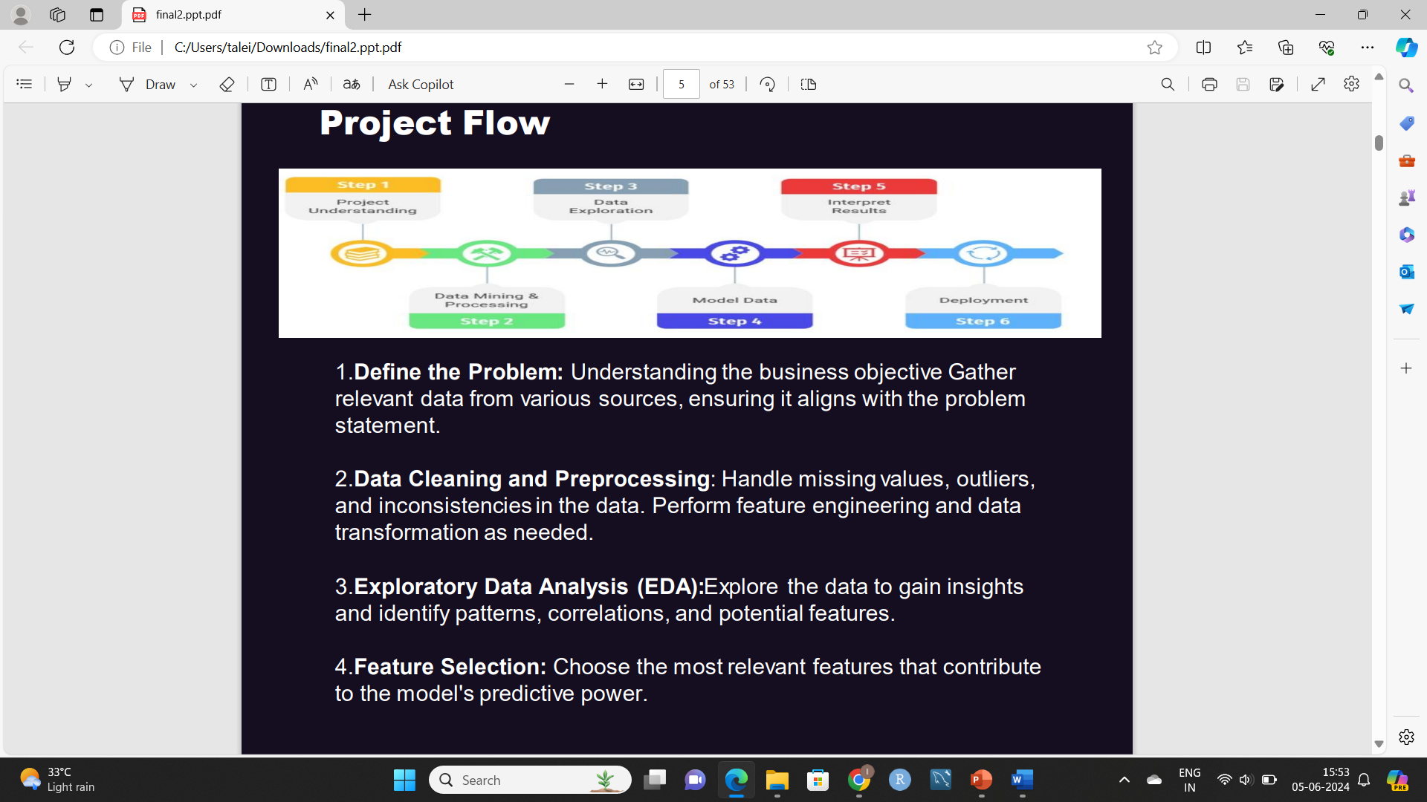
PROJECT FLOW
1. Understanding the business objective of the problem: Develop a customer
personality analysis system that helps the business understand its target customer better and tailor its products or marketing strategies accordingly. Specifically, it includes
Analyse customer behaviour
Segment customers and identify potential customers
Provide insights for decision-making and Optimize marketing efforts

Slide 6
2. Data Cleaning and Preprocessing: This steps includes the following
Dropping unnecessary columns
Checking for missing values and imputing them
Checking the data structure
Checking the duplicate values
Outlier Detection
3. Exploratory Data Analysis(EDA):
It is basically done to gain insights, identify patterns and understand relationships between variables.
Visualisation techniques includes histogram, scatterplot, bar graphs, heatmap etc.
4. Feature Engineering: It involves transforming raw data into meaningful feature that can improve the performance of the predictive model. The steps involved in it are

Slide 7
Feature Scaling
Encoding Categorical Variables
Dimensionality Reduction (PCA)
Feature Transformation
5. Model Selection: Choose an appropriate machine learning algorithm based on the nature of the problem (classification, regression, etc.) and the characteristics of the data.
6. Model Training: Split the data into training and testing sets. Train the model using the training data.
7. Model Evaluation: Evaluate the model’s performance on the testing data using appropriate metrics. Fine-tune hyperparameters to improve performance.

Slide 8
8. Model Interpretation: It is the process of understanding and explaining the predictions made by model. It is crucial for ensuring that the models are transparent, trustworthy and actionable.
9. Validate the model’s performance: This step involves a combination of splitting the data, cross-validation, using appropriate evaluation metrics, analysing confusion matrices, and utilising learning and validation curves. These steps ensures that the model is robust, generalizes well to new data, and performs optimally in real-world scenarios.
10. Deployment: Deploying a machine learning model involves making the trained model available for use in a production environment where it can make predictions on new data.

Slide 9
DATA COLLECTION
It is a fundamental step in any customer segmentation analysis. Effective data collection ensures that the dataset is comprehensive, accurate, and relevant for the analysis.

Slide 10
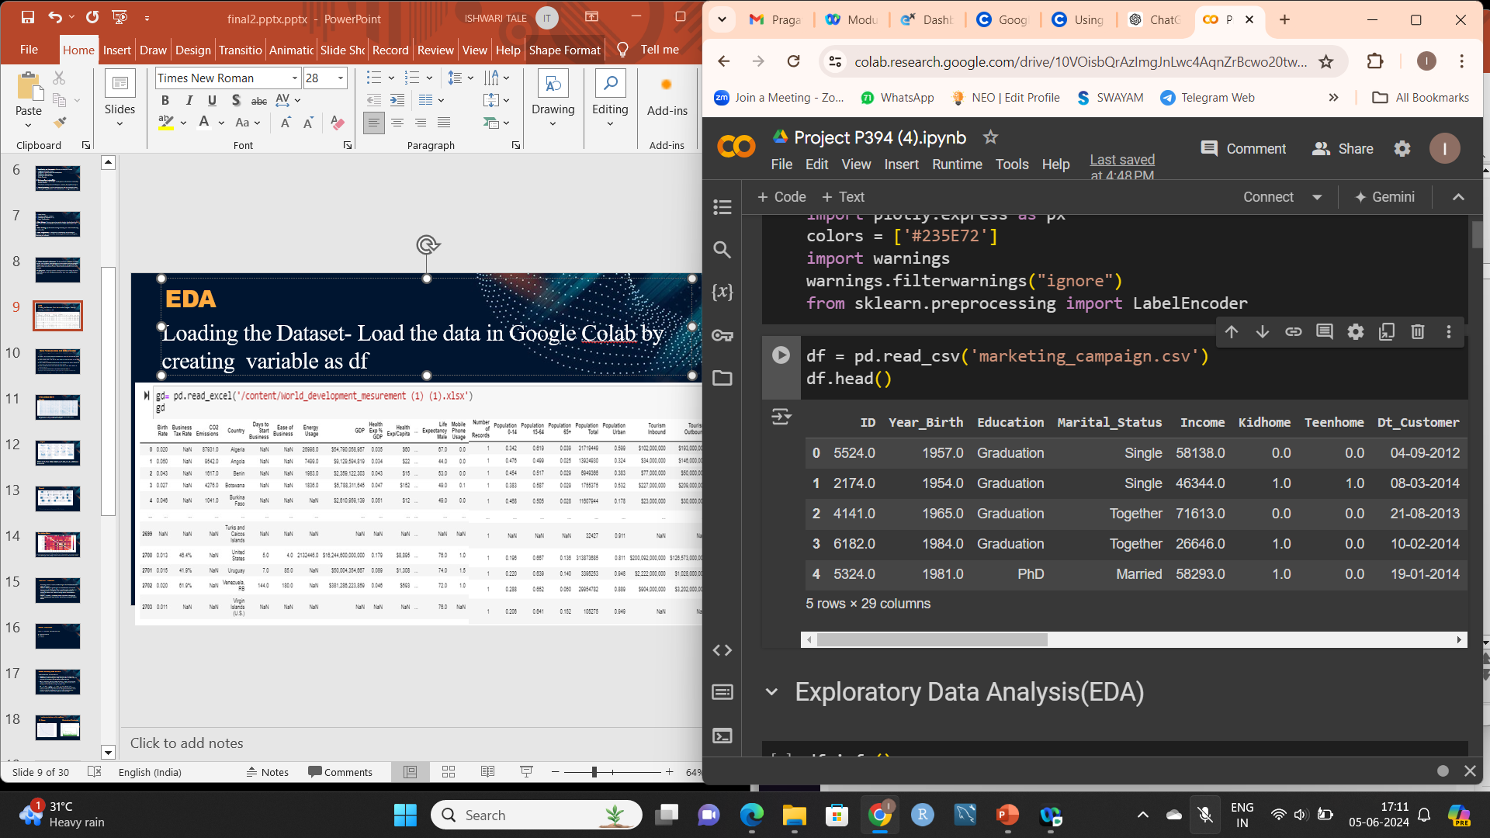
LOADING THE DATASET
Load the data in Google Colab by creating variable as df

Slide 11
EXPLORATORY DATA ANALYSIS (EDA)
It is a critical step in the data analysis process where analysts use various techniques to summarize the main characteristics of a dataset, often with visual methods. The goal of EDA is to understand the data, uncover patterns, spot anomalies, test hypotheses, and check assumptions.

Slide 12
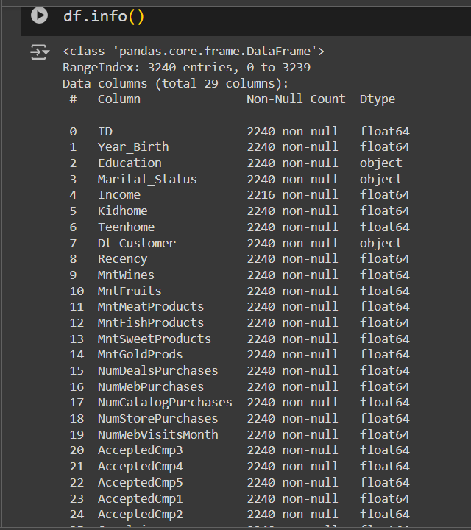
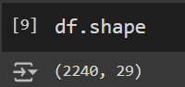
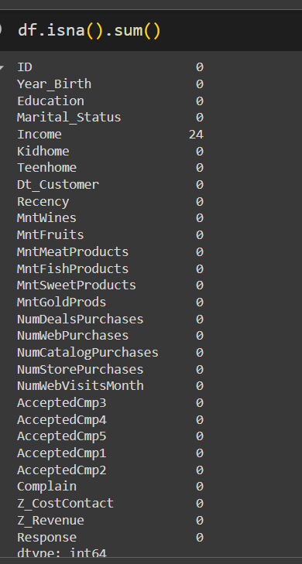
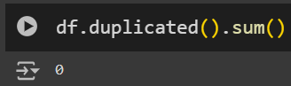
DATA EXPLORATION AND CLEANING
There are 2240 rows and 29 columns in the dataset.
Here we understood that the data types of each column, the number of non-null values in each column along with memory usage of the data frame.
There are no duplicated records in the dataset.
We observed that there are 24 null values in ‘Income’ Column.

Slide 13
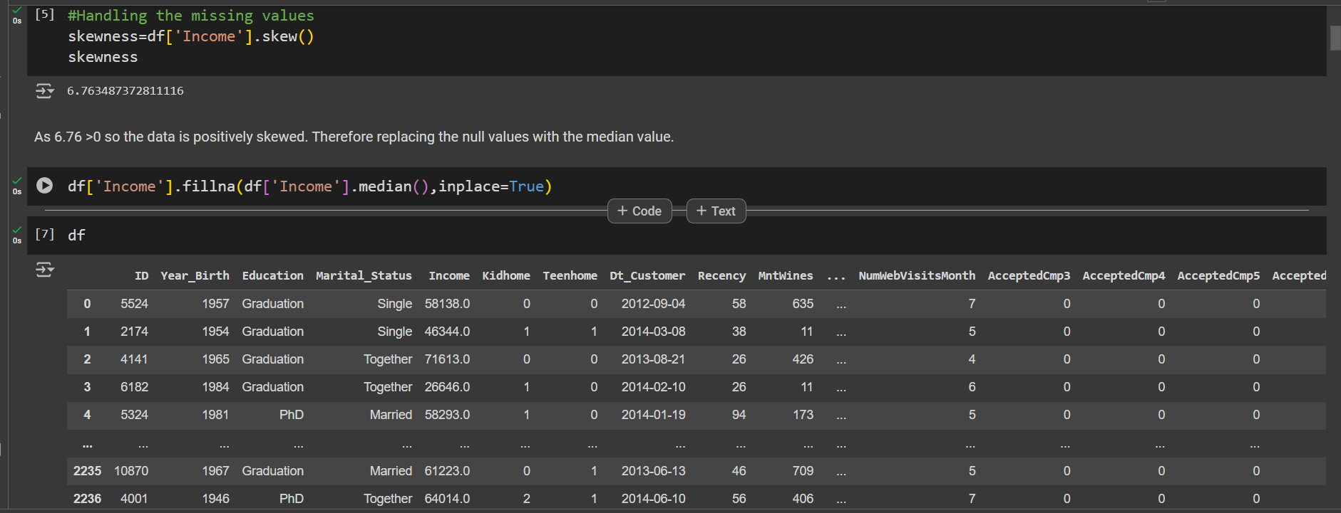
HANDLING THE MISSING VALUE

Slide 14
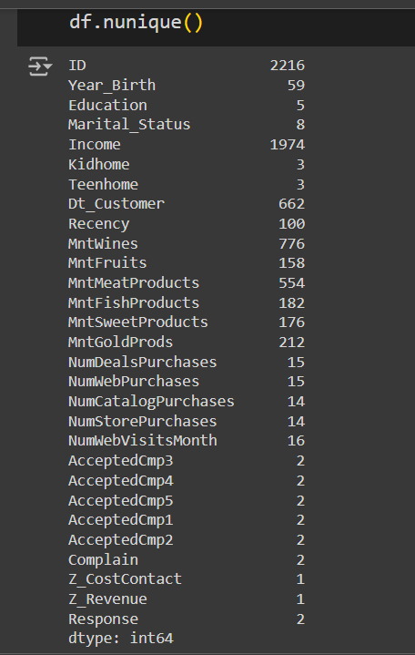
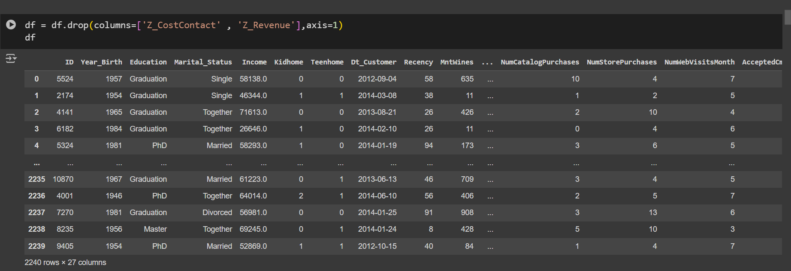
Here we get to know the unique values of each column. ‘Z_CostContact’ and ‘Z_Revenue’ have same values in all the rows that’s why they are not going to contribute anything in the model building so we can drop them.

Slide 15
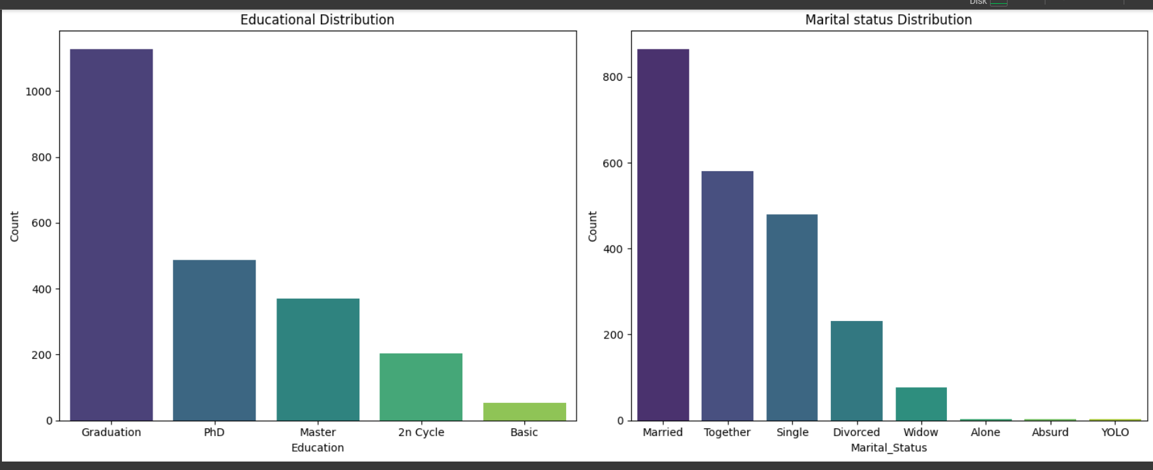
VISUALIZATION BAR GRAPH
It is a visual representation of data using rectangular bars, each bar’s length or height is proportional to the value it represents.
Observing the bar graphs above we identified the count of each categorical column.

Slide 16
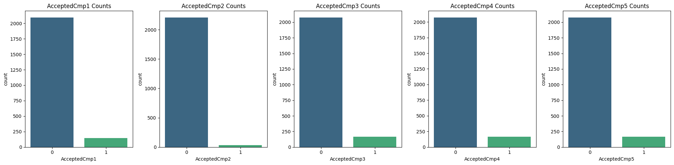
SUBPLOTS
Subplots allow you to create multiple plots in a single figure, making it easier to compare different views of the same data.
Selecting the relevant columns for the campaign acceptance analysis
Not Accepted: 2074 customer
Accepted: 142 customers
Acceptance Rate: Aprx 6.43%
Not Accepted: 2210 customer
Accepted: 30 customers
Acceptance Rate: Aprx 1.34%
Not Accepted: 2077 customer
Accepted: 163 customers
Acceptance Rate: Aprx 7.28%
Not Accepted: 2073 customer
Accepted: 167 customers
Acceptance Rate: Aprx 7.47%
Not Accepted: 2077 customer
Accepted: 163 customers
Acceptance Rate: Aprx 7.28%

Slide 17
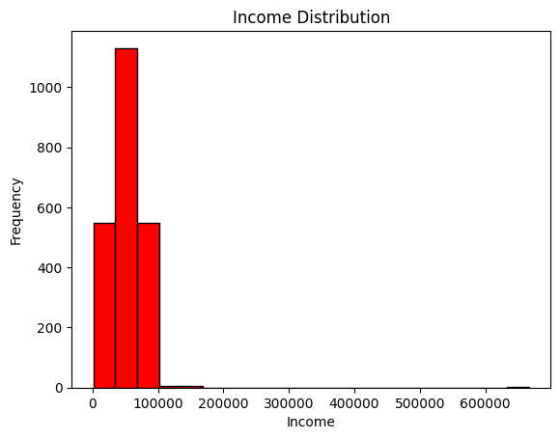
HISTOGRAM
It is a chart that plots the distribution of a numeric variable’s value as a series of bars.
There is a significant difference between the maximum value and the majority of the data , which is causing the histogram to be skewed and not fully display the distribution.
Also there is an outlier present in the data.
ve skewness present.

Slide 18
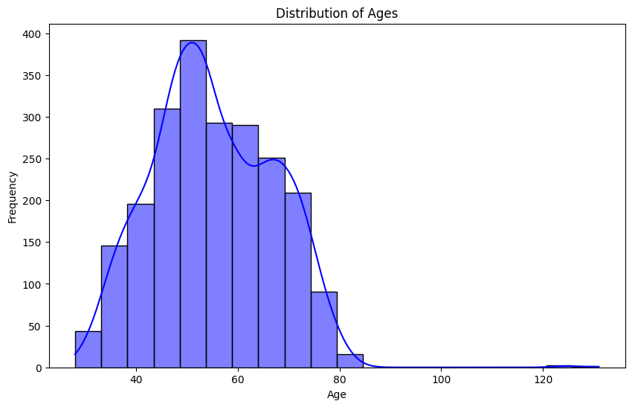
Mode: The most frequent age is around 55
Distribution: The age distribution is approximately normal with a slight right skew.
Outliers: A small number of outliers exist above the age of 100.
The blue KDE(Kernel density Estimate) lines smooths out the distribution and highlighting the most probable age ranges more clearly.
This plot is useful for understanding the age demographics in the dataset, indicating that the majority of individuals are middle-aged to older adults.

Slide 19
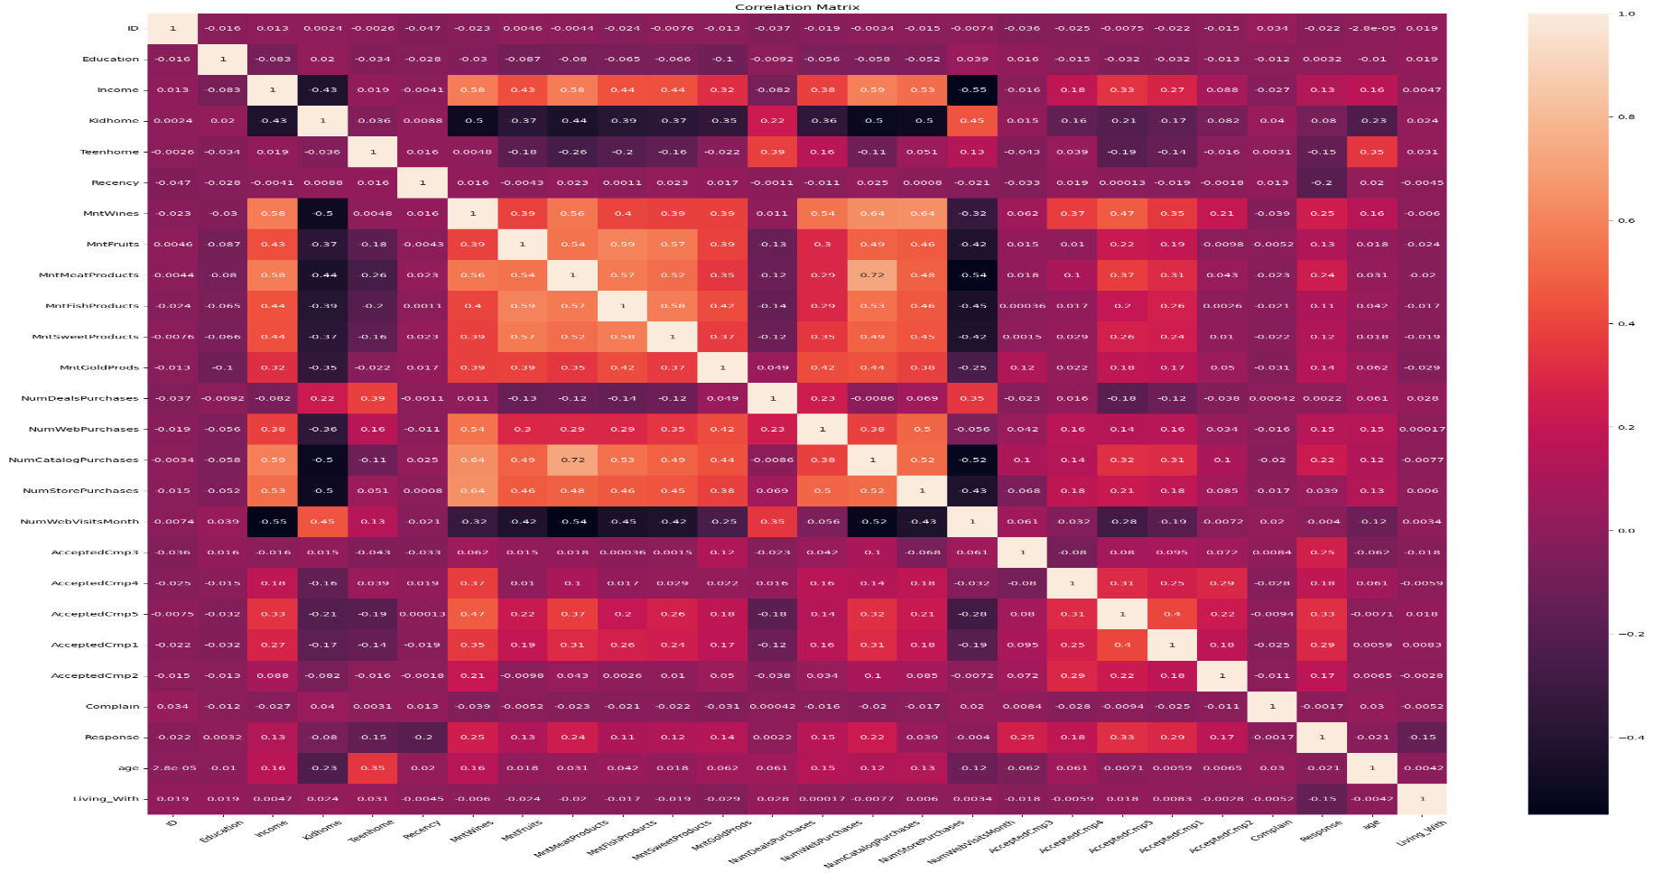
CORRELATION MATRIX
It is a table showing correlation coefficients between variables. Each cell in the matrix shows the correlation between two variables, indicating the strength and direction of their relationship.

Slide 20
OBSERVATIONS:
Income and Education have a moderately positive correlation (around 0.44), suggesting that higher education is associated with higher income.
NumWebPurchases and NumCatalogPurchases have a high positive correlation (around 0.72), indicating that people who buy more from the web also tend to buy more from catalogs.
NumDealsPurchases and NumWebPurchases have a strong positive correlation (around 0.59), suggesting that deal purchases are common among frequent web purchasers.
MntWines and MntGoldProds have a strong positive correlation (around 0.63), indicating that people who spend more on wines also spend more on gold products.
AcceptedCmp1 through AcceptedCmp5 show varying degrees of positive correlation among themselves, indicating some customers tend to accept multiple campaigns.
Age shows a moderate positive correlation with Income (around 0.35), implying that older individuals may have higher income.

Slide 21
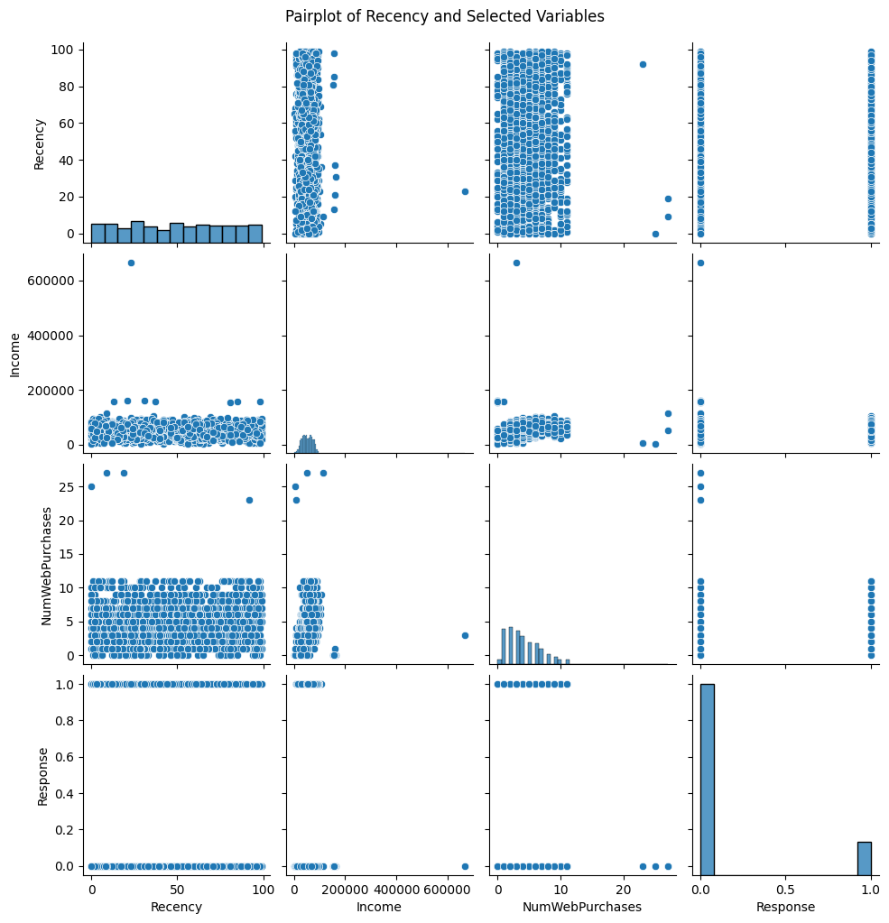
PAIR PLOT
Pair Plot allows us to visualize relationships between pairs of variables in a dataset.
Recency vs Other variables:
There doesn’t seem to be a strong correlation between Recency and Income , as indicated by the spread of points.
Recency and NumWebPurchases also do not show a clear pattern, indicating low correlation.
The scatterplot between Recency and Response shows that Recency values are spread similarly for both response categories, suggesting no clear relationship.

Slide 22
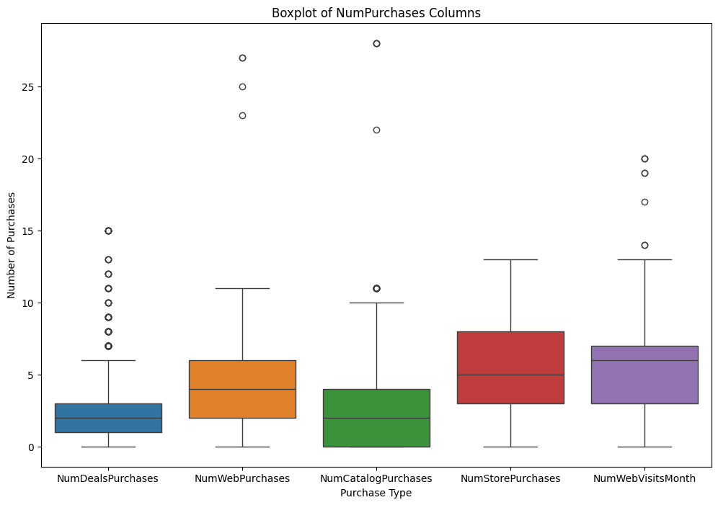
BOXPLOT
It is a graphical representation of the distribution of a dataset which shows the median and quartiles
The presence of outliers indicates that some customers have much higher purchase frequencies or web visits than the typical range, suggesting highly active or engaged customers.

Slide 23
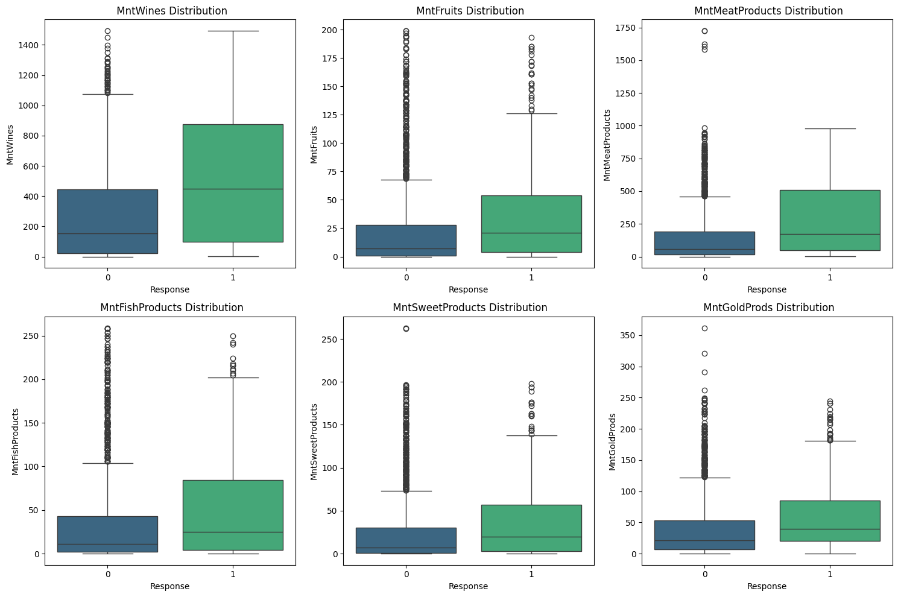
The above boxplot represents the presence of outliers in the data

Slide 24
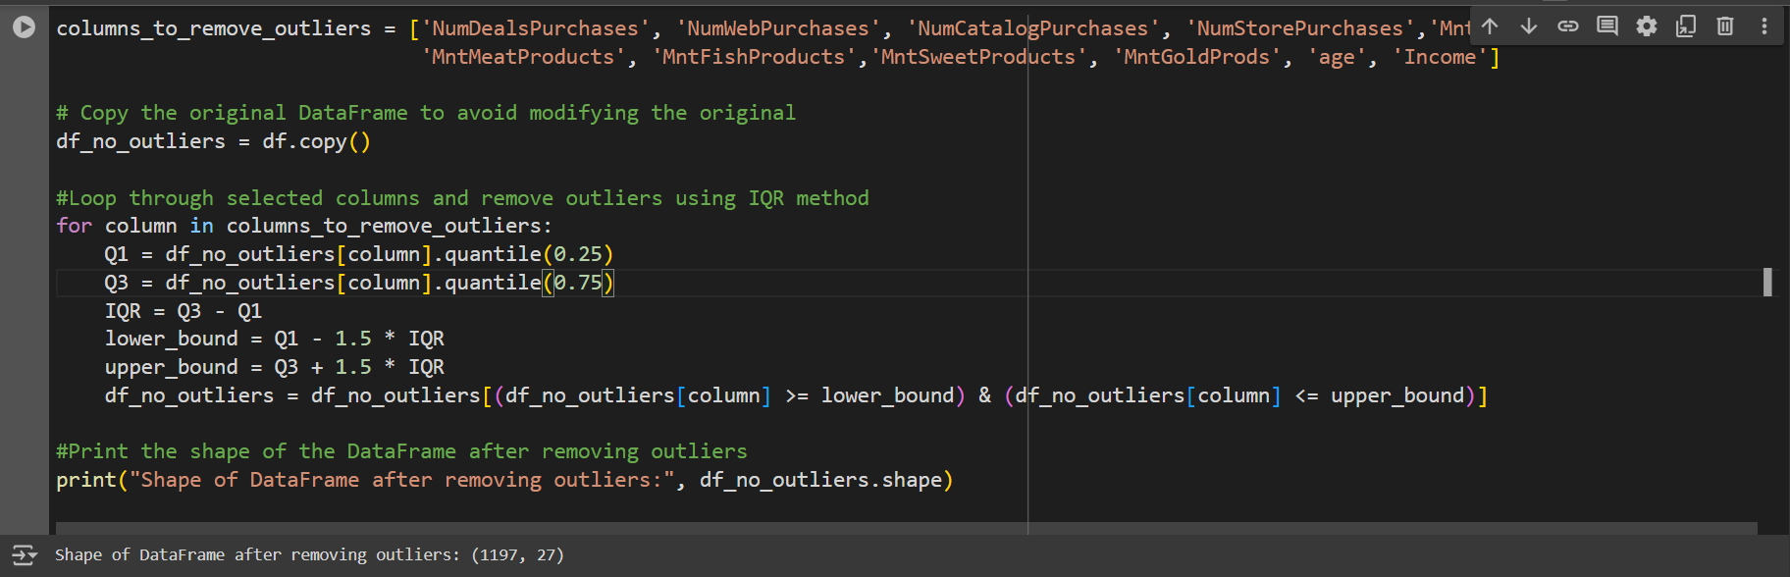
OUTLIERS TREATMENT
One of the most important steps as a part of data preprocessing is detecting and treating the outliers as they can negatively affect the statistical analysis and the training process of a machine learning algorithm resulting in lower accuracy. So we have to remove outliers from the dataset.

Slide 25
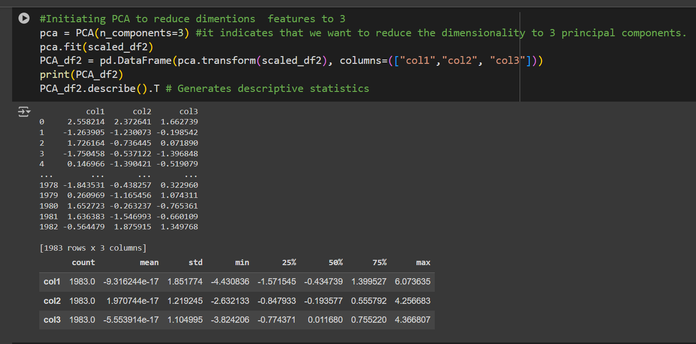
DIMENSIONALITY REDUCTION USING PCA
Principal Component Analysis(PCA) is a technique for
reducing the dimensionality of such datasets, increasing
interpretability but at the same time minimizing information loss.

Slide 26
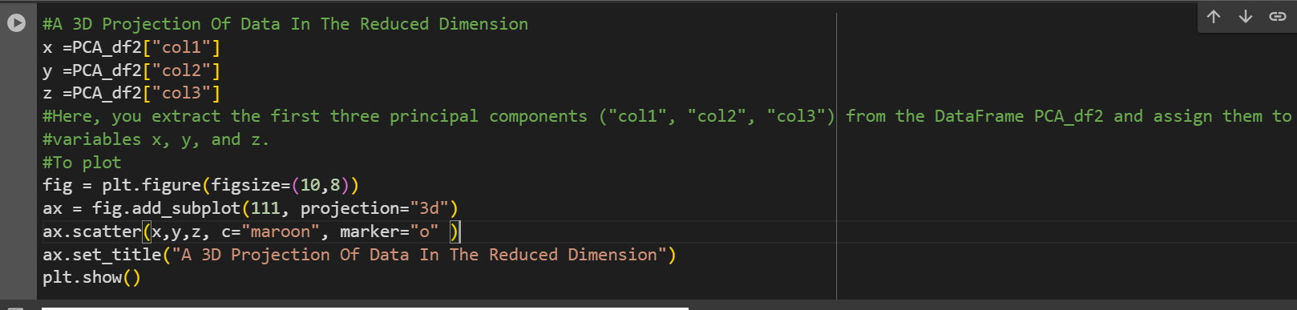
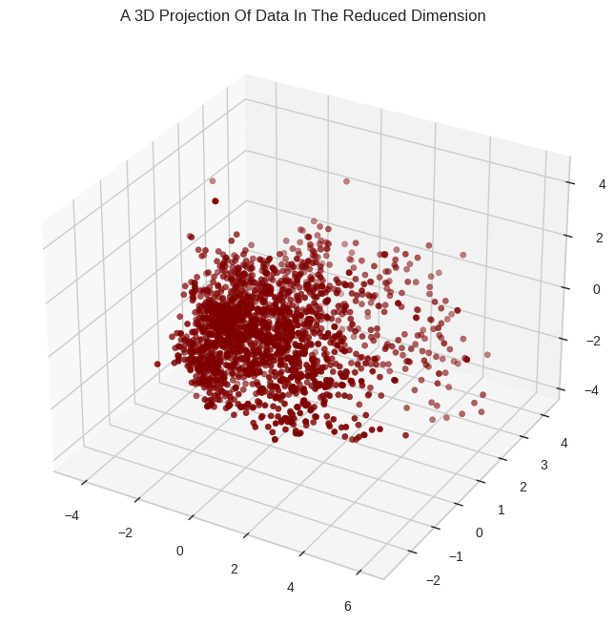
By plotting in 3D plot we can get deeper understanding of data that have three variables.

Slide 27
MODEL BUILDING
It is the process of creating and developing statistical or machine learning models to make predictions, infer relationships, or classify data based on patterns learned from a training dataset.

Slide 28
MODEL BUILDING
The Algorithms implemented are:
Clustering
DBSCAN
KMeans

Slide 29
1. CLUSTERING
Clustering: It is a type of unsupervised machine learning algorithms used to group similar data points together based on their features. The goal is to partition the data into clusters, where points in the same cluster are more similar to each other than those in other clusters.
Hierarchical Clustering: It builds a hierarchy of clusters that can be represented in
a tree like diagram called as Dendrogram.

Slide 30
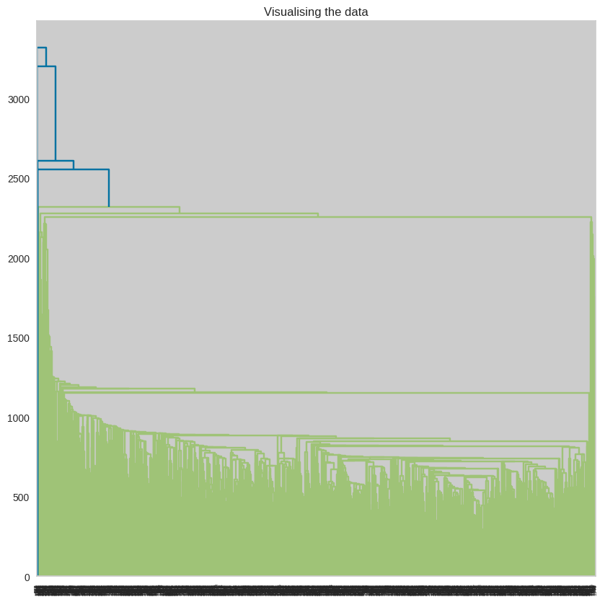
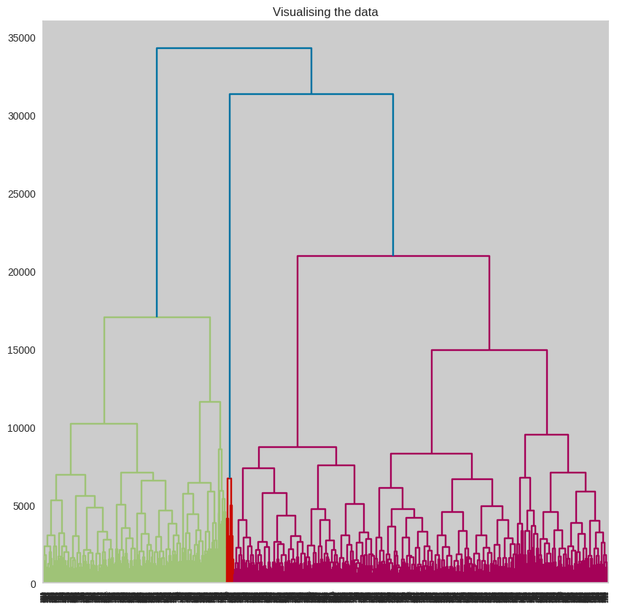
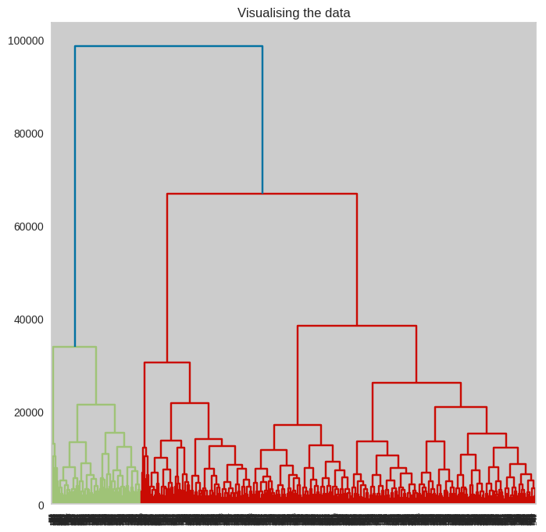
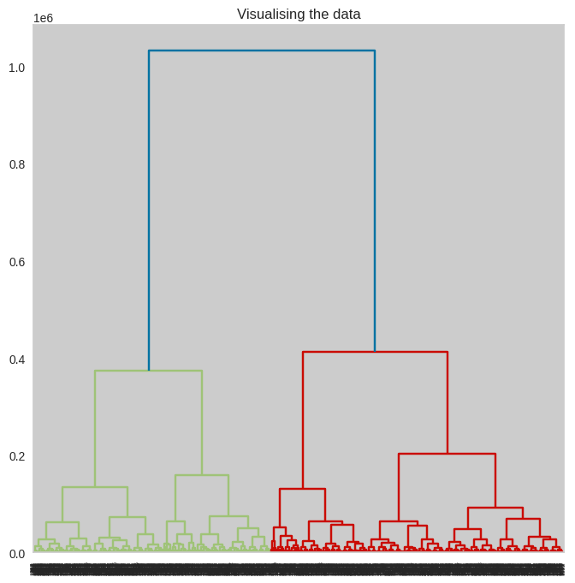
HIERARCHICAL CLUSTERING
1. Using Single Linkage Method
3. Using Average Linkage Method
2. Using Complete Linkage Method
4. Using Ward Linkage method

Slide 31
2. DBSCAN
DBSCAN: (Density Based Spatial Clustering of Application with Noise) is a clustering that is particularly well-suited for identifying clusters of varying shapes and sizes, and it can handle noise(outliers) effectively.

Slide 32
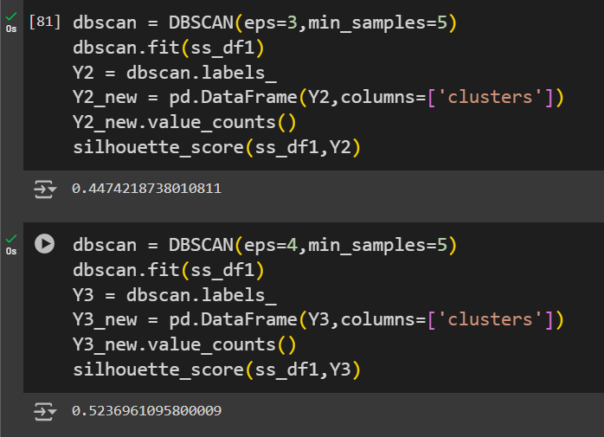
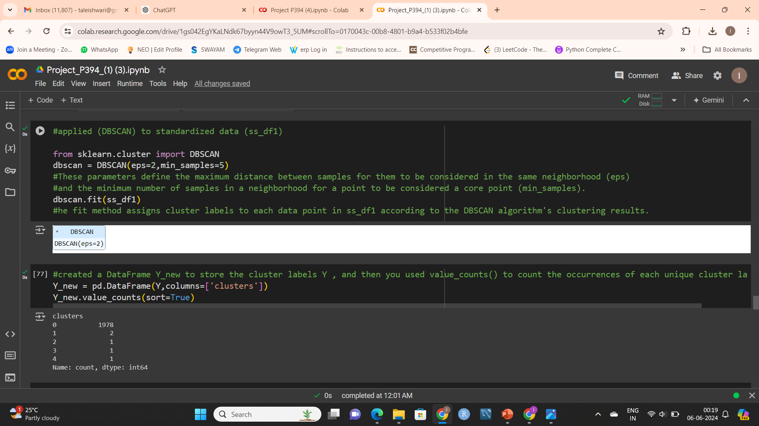
DBSCAN
DBSCAN has two main parameters: ‘eps’ (maximum distance between two points to be considered neighbors) and ‘min_samples’ (minimum number of points to form a dense region).
Proper tuning of these parameters is crucial. A poor choice can lead to inappropriate clustering, affecting the Silhouette Score.

Slide 33
3. KMeans
KMeans: It is an algorithm which is used for partitioning a dataset into k clusters. It ais to minimize the variance within each cluster, ensuring that the data points within a cluster are as similar as possible.

Slide 34
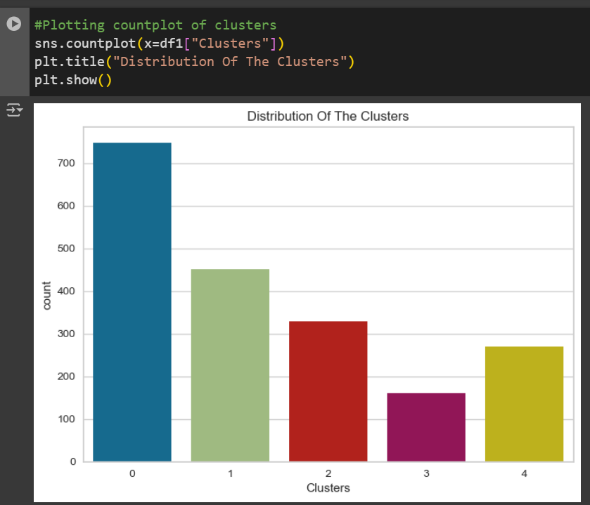
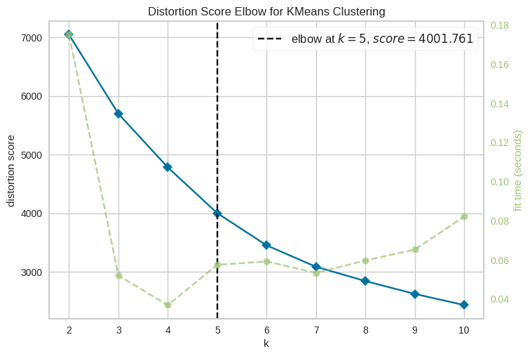
K-Means
Here WCSS distance drastically dropped at the point 5, therefore the best value of k here is 5.

Slide 35
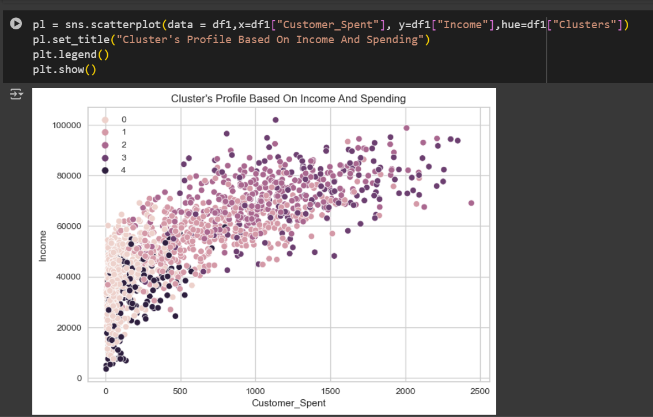
Conclusion
Cluster 0-
high income low speed
Cluster 1 – highest spent and highest earning
Cluster 2-
low income low spend
Cluster 3 – high income high spending
Cluster 4 –lowest spent low income

Slide 36
There are 3 Types of Models
Overfitted: If training accuracy is very high and testing accuracy is very low (more than 3 % of difference) it is overfitted model.
Underfitted : If the model is not able to perform good in training as well as in testing it is an underfitted model.
Generalized: Both training accuracy and testing accuracy is high (less than 3% difference between training and testing accuracy

Slide 37
With Supervised Machine Learning Algorithm
Algorithms used are:
Decision Tree
Logistic Regression
KNeighbour Classifier
Random Forest
SVM

Slide 38
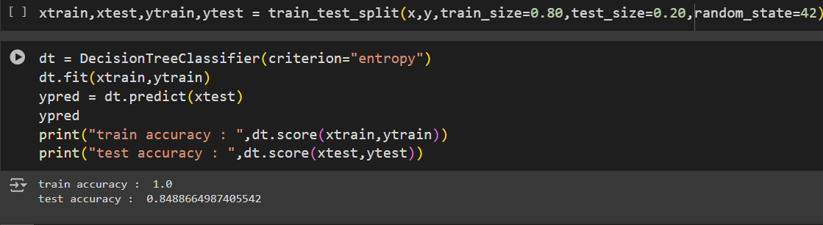
1. DECISION TREE
It is a graphical representation used in decision making and machine learning.
It Splits data into branches to help make decisions based on certain conditions.
Each node represents a decision point or a test to an attribute, each branch represents the outcome of the test, and each leaf node represents a final decision or classification.

Slide 39
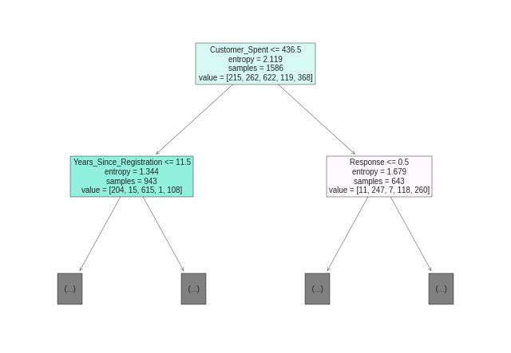
Customer_spent is our root node , te highest information gain value which is most important for model building.
We are getting overfitted result as there is large difference between traing accuracy and testing accuracy.

Slide 40
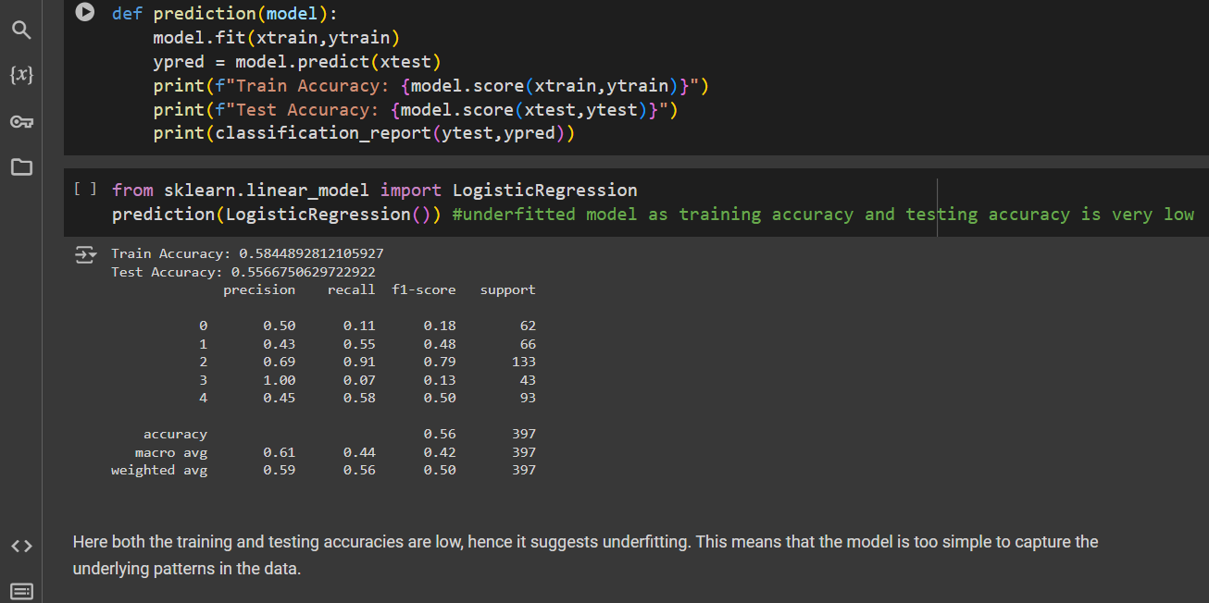
2.LOGISTIC REGRESSION
It is statistical method used for binary classification problems, where the outcome variable is categorical with two possible outcomes(e.g., yes/no, true/false).
It models the probability of certain class or event.

Slide 41
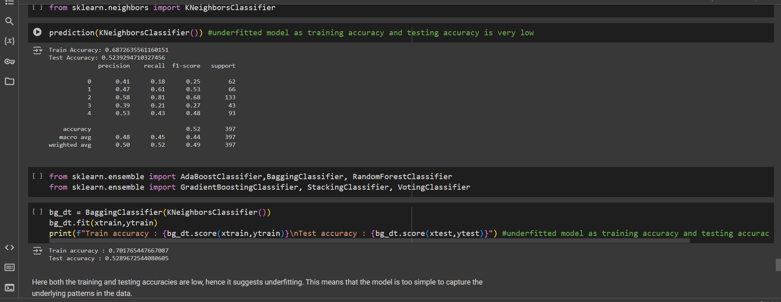
3. KNEIGHBOUR CLASSIFIER
It is a simple, non-parametric, and instance-based learning algorithm used for both classification and regression task.
It classifies a data point on how its neighbour are classified.

Slide 42
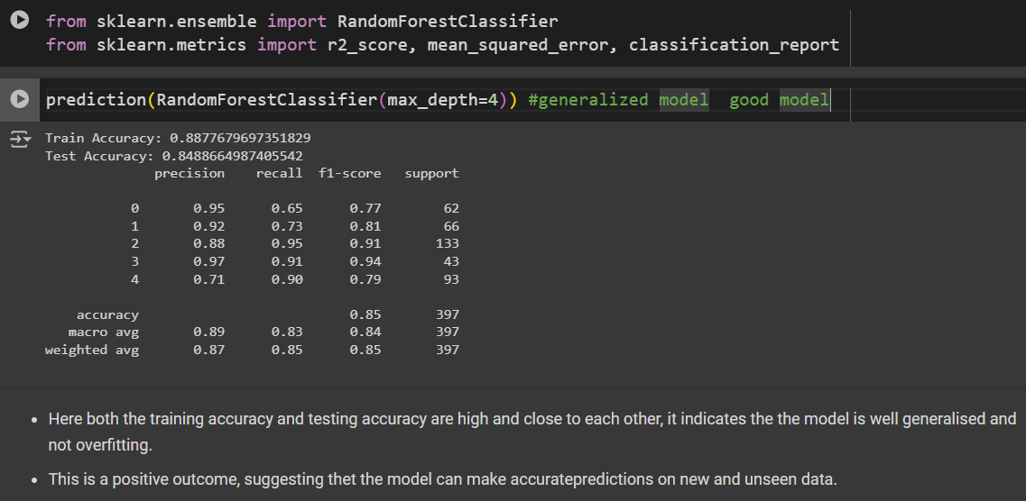
4. RANDOM FOREST
It is a supervised machine learning algorithm used for both classification and regression.
It builds multiple decision tree using different subsets of data and averages their predictions to improve the accuracy and prevent overfitting.

Slide 43
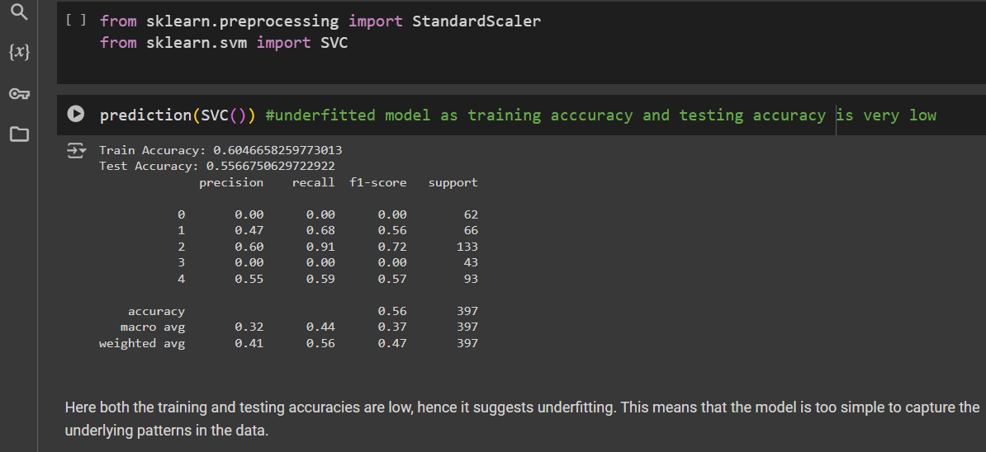
5.SVM
Support Vector Machine (SVM) is supervised machine learning algorithm used for classification and regression tasks.
It works by finding the hyperplane that best separates the data into different classes.
Hyperplane is a decision boundary that maximises the margin between different classes.

Slide 44
CONCLUSION
After performing the different models we came to the conclusion that the Random Forest is the best performing model as it gives very high testing accuracy as well as training accuracy also it reduces the overfitting and handles noise as well.

Slide 45
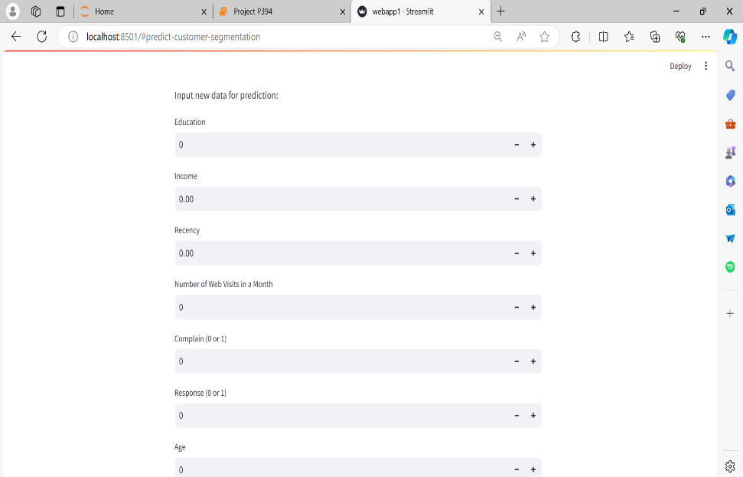
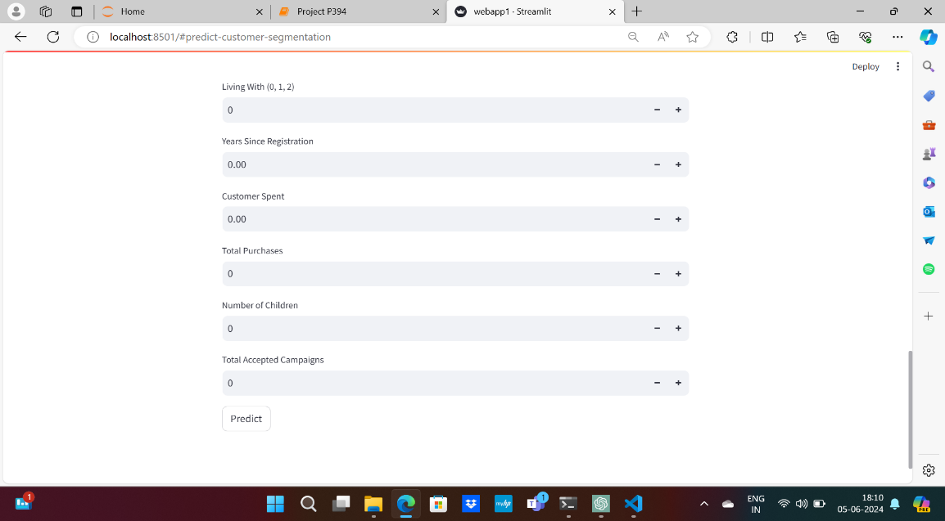
DEPLOYMENT
Deployment in Machine Learning is the method by which you integrate a machine learning model into an existing production environment to make decisions based on data. It is the last stage in the machine learning lifecycle.
We first deployed eight models , amongst them the Random Forest Classifier Model is used and deployed using Stremlit.

Slide 46
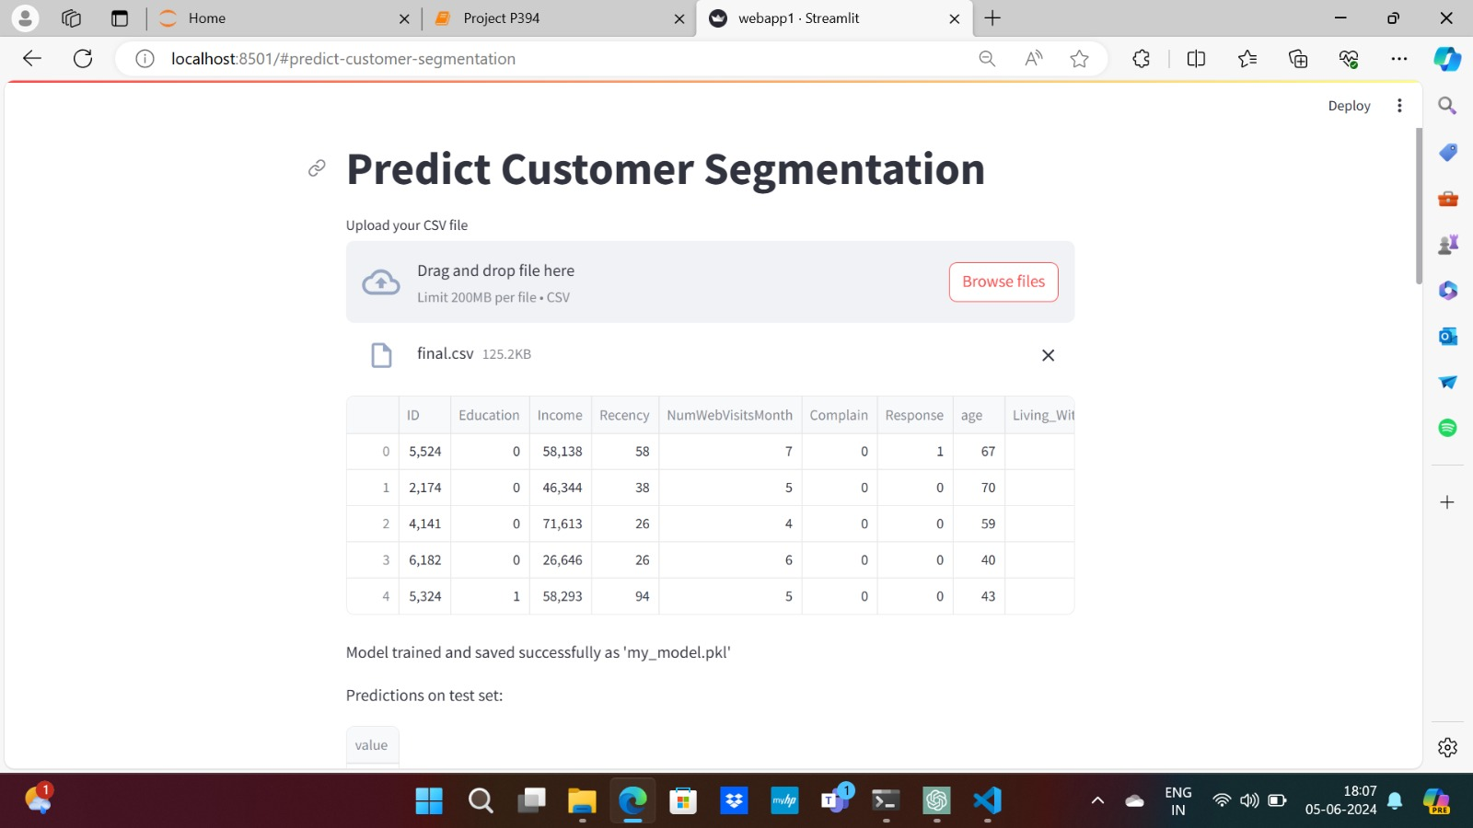
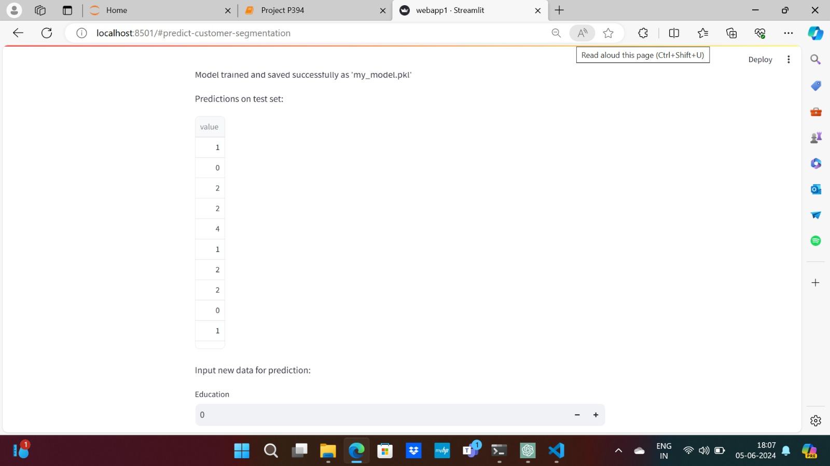

Slide 47
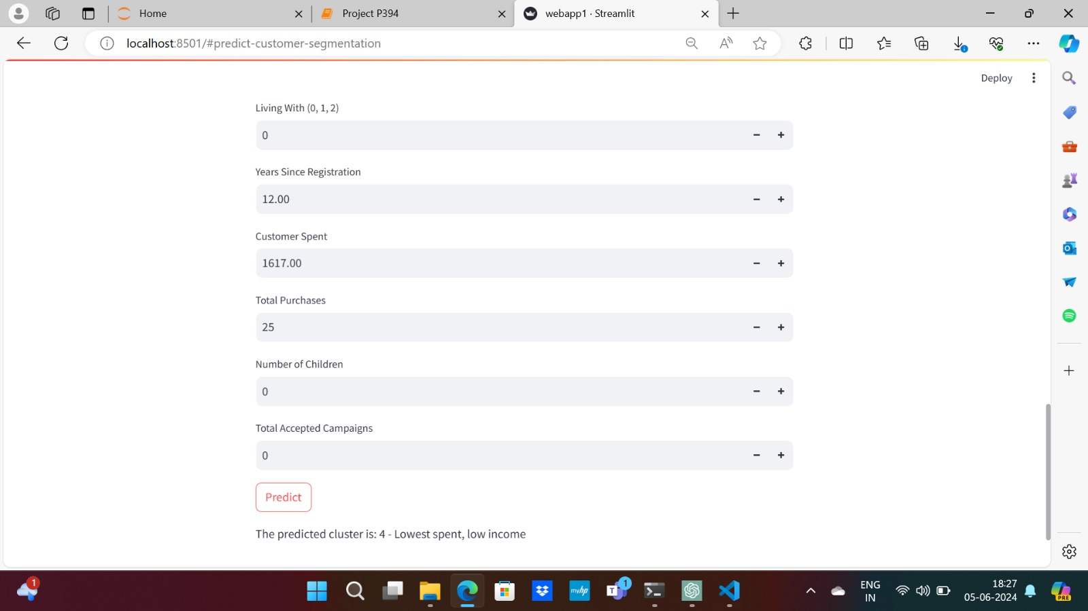

Slide 48
CHALLENGES FACED DURING DEPLOYMENT
Displaying visualization of the data set was difficult
Deploying a model that can handle large volumes of customer data efficiently while maintaining performance was a challenge.
Complex machine learning models used for personality analysis lack interpretability, making it challenging to explain predictions to the clients.

Slide 49
OVERCOMING THESE CHALLENGES:
CHALLENGES FACED
1.Creating New Features: Generating meaningful features that capture important customer behaviours or characteristics often requires deep domain knowledge and creativity.
2. Algorithm Selection: Deciding whether to use k-means, hierarchical clustering, DBSCAN, or another algorithm depends on the data and the specific goals of the segmentation.
1.Creating the new features by combining the existing ones and develop the features that capture customer behaviour patterns.
2. Experiment with multiple clustering algorithms (e.g. k-means, DBSCAN, hierarchical clustering) to find the best fit for the data. Using metrics like Silhouette Score to evaluate and compare clustering performance.

Slide 50

THANK YOU

